Slide 1
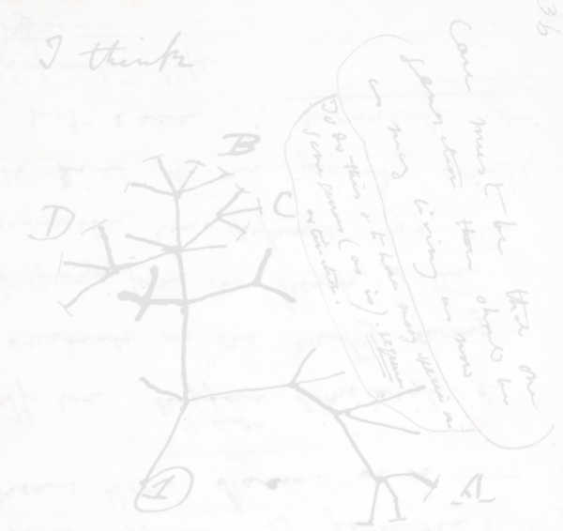
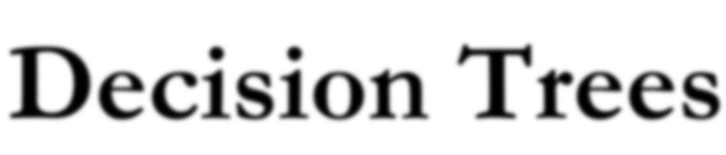


Slide 2
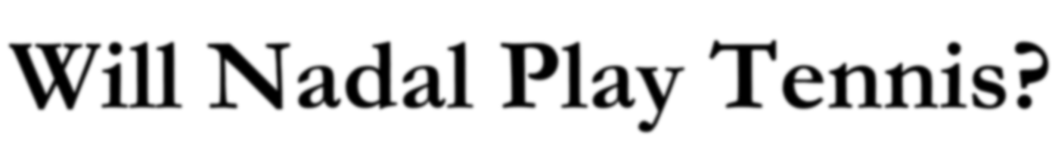



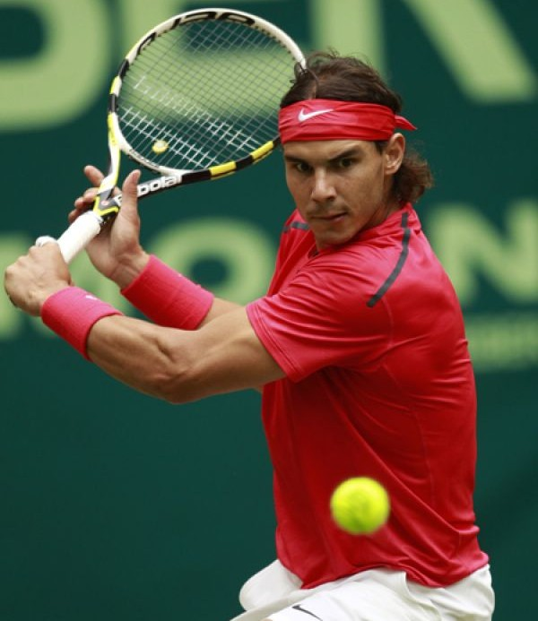
Day Outlook Temp Humidity Wind ^{Play} Tennis
1 | Sunny | Hot | High | Weak | No
2 | Sunny | Hot | High | Strong | No
3 | Overcast | Hot | High | Weak | Yes
4 | Rain | Mild | High | Weak | Yes
5 | Rain | Cool | Normal | Weak | Yes
6 | Rain | Cool | Normal | Strong | No
7 | Overcast | Cool | Normal | Weak | Yes
8 | Sunny | Mild | High | Weak | No
9 | Sunny | Cool | Normal | Weak | Yes
10 | Rain | Mild | Normal | Strong | Yes
11 | Sunny | Mild | Normal | Strong | Yes
12 | Overcast | Mild | High | Strong | Yes
13 | Overcast | Hot | Normal | Weak | Yes
14 | Rain | Mild | High | Strong | No
Rafael Nadal

Slide 3





















Day Outlook Temp Humidity Wind ^{Play} Tennis
1 | Sunny | Hot | High | Weak | No
2 | Sunny | Hot | High | Strong | No
3 | Overcast | Hot | High | Weak | Yes
4 | Rain | Mild | High | Weak | Yes
5 | Rain | Cool | Normal | Weak | Yes
6 | Rain | Cool | Normal | Strong | No
7 | Overcast | Cool | Normal | Weak | Yes
8 | Sunny | Mild | High | Weak | No
9 | Sunny | Cool | Normal | Weak | Yes
10 | Rain | Mild | Normal | Strong | Yes
11 | Sunny | Mild | Normal | Strong | Yes
12 | Overcast | Mild | High | Strong | Yes
13 | Overcast | Hot | Normal | Weak | Yes
14 | Rain | Mild | High | Strong | No
Outlook
Overcast
Humidity
Yes
Wind
No
Yes
No
Yes

Slide 4






































































Question 1
Question 2
Yes
No
Yes
No

Slide 5




















Question 3
Question 4
Yes
No
Yes
No
E(S) = —p₊log(p₊) — p—log(p—)

Slide 6










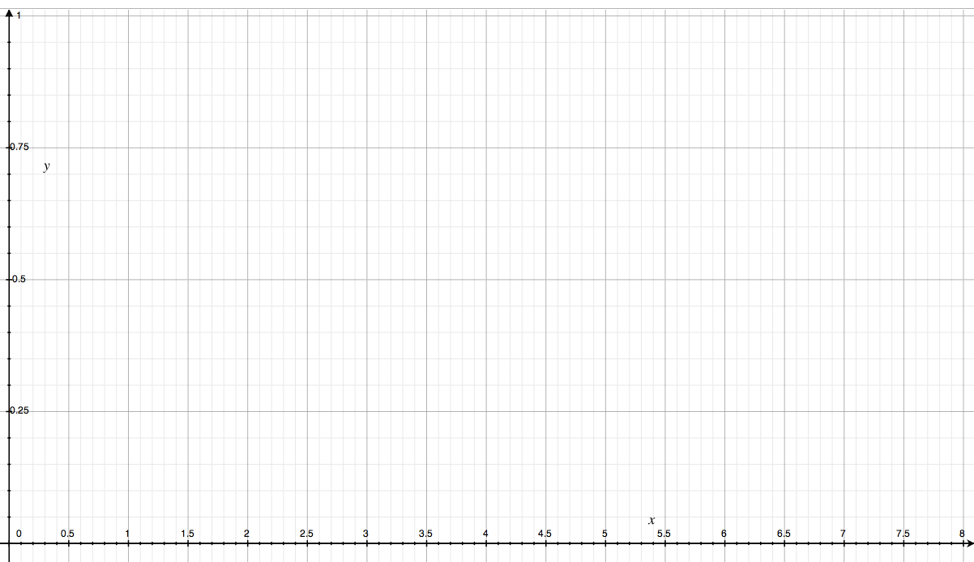


Slide 7



Slide 8



Slide 9



Slide 10



Slide 11



Slide 12



Slide 13



Slide 14



Slide 15
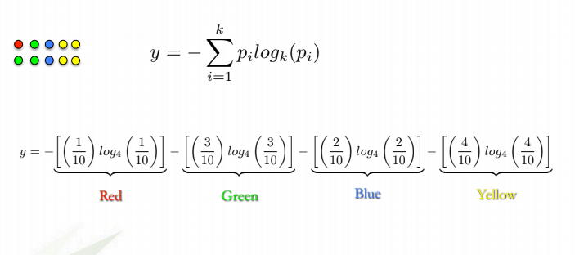
A dataset of only blues would have very low (in fact, zero) entropy
A dataset of mixed blues, greens, and reds would have relatively high entropy.

Slide 16



























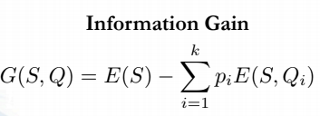
how can we quantify the quality of a split?
Question 1
Question 2
E=1
E=1
Yes
No
Yes
No
E=0.97
E=0.92
E=0.72
E=0
When training a Decision Tree using these metrics, the best split is chosen by maximizing Information Gain.

Slide 17
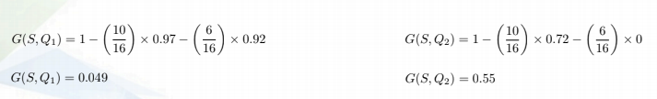
Question 1
Question 2
E=1
E=1
Yes
No
Yes
No
E=0.97
E=0.92
E=0.72
E=0

Slide 18
Day Outlook Temp Humidity Wind ^{Play} Tennis
1 | Sunny | Hot | High | Weak | No
2 | Sunny | Hot | High | Strong | No
3 | Overcast | Hot | High | Weak | Yes
4 | Rain | Mild | High | Weak | Yes
5 | Rain | Cool | Normal | Weak | Yes
6 | Rain | Cool | Normal | Strong | No
7 | Overcast | Cool | Normal | Weak | Yes
8 | Sunny | Mild | High | Weak | No
9 | Sunny | Cool | Normal | Weak | Yes
10 | Rain | Mild | Normal | Strong | Yes
11 | Sunny | Mild | Normal | Strong | Yes
12 | Overcast | Mild | High | Strong | Yes
13 | Overcast | Hot | Normal | Weak | Yes
14 | Rain | Mild | High | Strong | No

Slide 19













E=0.954
Wind
E=0.811
E=1

Slide 20







G(S, Wind) = 0.048
E=0.954
Humidity
E=0.985
E=0.592

Slide 21


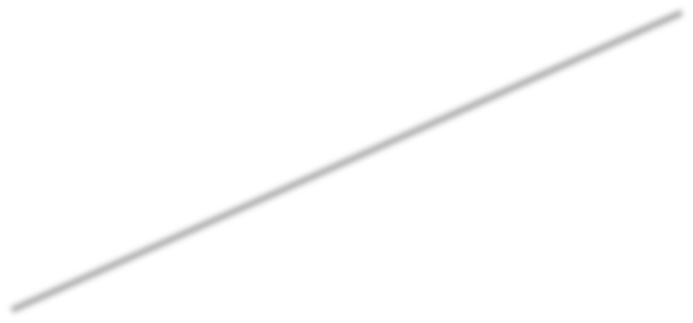
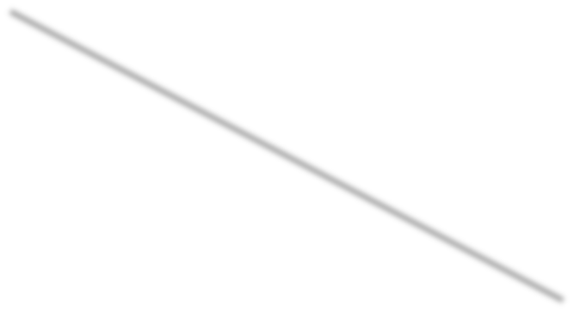








G(S, Wind) = 0.048
G(S, Humidity) = 0.151
E=0.954
Temp
Mild
E=1
E=0.92
E=0.81

Slide 22






G(S, Wind) = 0.048
G(S, Humidity) = 0.151
E=0.954
G(S, Temp) = 0.042
Outlook
Overcast
E=0.971
E=0
E=0.971

Slide 23












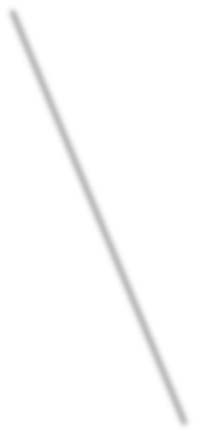

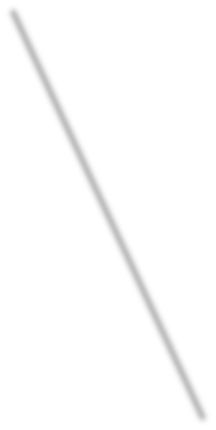







Outlook
Overcast
Humidity
Yes
Wind
No
Yes
No
Yes

